Slide 1



Font Generation Using GAN
Font generation using Generative Adversarial Networks (GAN) is a fascinating process that involves creating unique and aesthetically pleasing typefaces through artificial intelligence. The digital art depicts the futuristic and abstract nature of this innovative technology.
by Dhanush Naidu

Slide 2

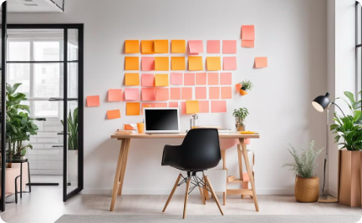

Agenda
Planning
Creative Brainstorming
Collaboration
Structured organization and meticulous planning are essential for successful font generation projects.
Encouraging creativity and out-of-the-box thinking is a crucial aspect of the font design process.
Effective teamwork and collaboration among team members are vital for a cohesive and efficient workflow.

Slide 3

Problem Statement
1
Data Diversity
2
Quality Control
Obtaining diverse datasets to train the GAN for font generation can be challenging but is crucial for producing versatile and unique fonts.
Ensuring the quality and consistency of generated fonts is a significant challenge in the GAN-based font creation process.
3
Computational Complexity
The computational resources and processing power required for GAN-based font generation can be substantial, posing a technical challenge.

Slide 4
Project Overview
Research
Development
Evaluation
Thorough research into font styles and design trends lays the foundation for the font generation project.
Iterative development and refining of generated fonts based on feedback and testing are crucial for achieving high-quality results.
Conducting comprehensive evaluations and assessments to ensure the generated fonts meet the desired standards and objectives.

Slide 5




Who are the end users?
Graphic Designers
Branding Agencies
Web Developers
Professional graphic designers seeking unique and customizable font options for their creative projects.
Branding agencies aiming to differentiate their clients' brand identities through exclusive and captivating typography.
Web developers and UI/UX designers in need of innovative and visually appealing font styles for digital interfaces.

Slide 6
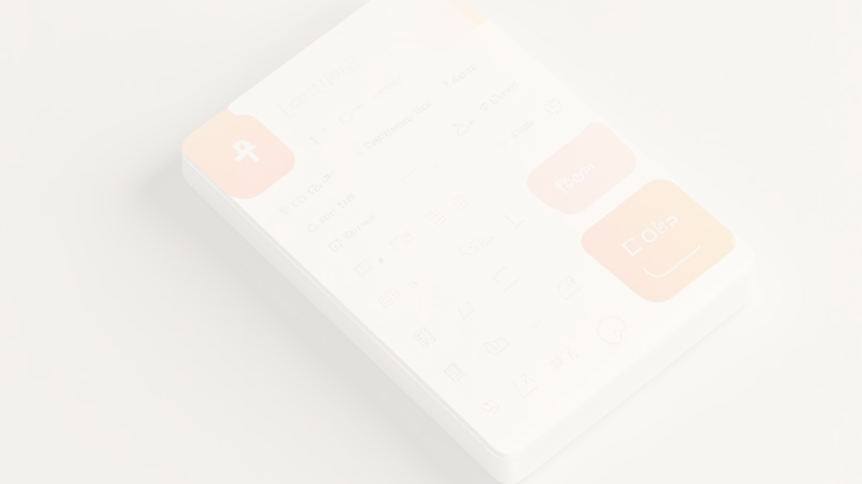
Your solution and its value proposition
Customization
Creativity Empowerment
Efficiency
Offering customizable and adaptable font generation solutions tailored to specific project requirements.
Streamlining font generation processes to save time and effort while maintaining high quality and creativity.
Empowering designers and creators to explore and realize their artistic vision through unique font designs.

Slide 7




The wow in your solution
Innovative
Versatile
Dynamic
Inspiring
Revolutionizing the font design industry with cutting-edge GAN-based generation techniques.
Unleashing a diverse range of font styles that cater to various design preferences and applications.
Adapting to evolving design trends and providing continuously updated font options.
Fostering creativity and inspiration through captivating and one-of-a-kind font designs.

Slide 8
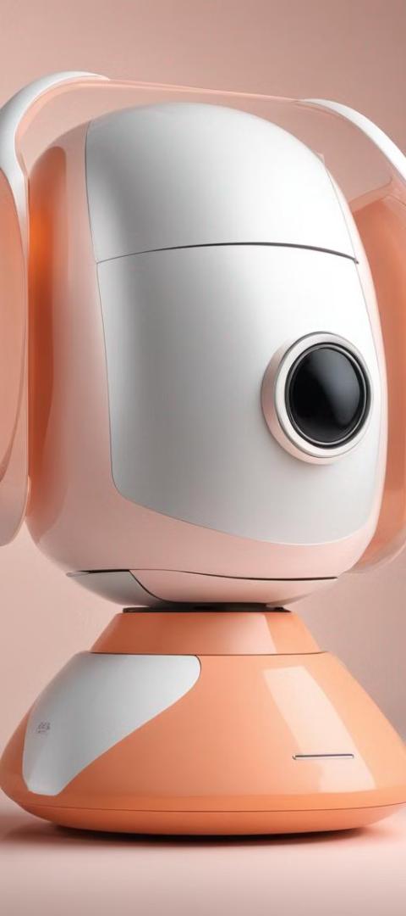
Modeling
1
Training GAN
Training the GAN model using diverse datasets to capture a wide spectrum of font design elements.
2
Feedback Loop
Implementing feedback mechanisms to refine and enhance the generated fonts based on user input and preferences.
3
Quality Assurance
Conducting rigorous quality checks and evaluations to ensure the generated fonts meet industry standards.

Slide 9
Result
Unique Fonts
High Customizability
Diverse Styles
Scalable Solutions
Optimized Workflows
Enhanced Creativity

